Slide 1
3D Plane Detection via Hough Transform
Anthony Duca

Slide 2
Plane Detection
Problem: You have a point cloud containing many points and want to detect planes in this point cloud to find features (walls, floors, ceilings, sides of buildings, fences, rows of objects, etc.).
Hough Transform: Have every point in the point cloud vote for every possible plane it is a part of then pick the planes with the most votes.
Works for any parameterizable shape. Planes can be parameterized by their normal vector in spherical coordinates. (rho,theta,phi).

Slide 3
Algorithm
Step 1: Perform hough transform to build accumulator of votes.
Step 2: Perform non-maximum suppression to eliminate all planes that are not local-maxima in the accumulator
Step 3: Pick planes that have the highest number of votes.

Slide 4
Suitability for GPU acceleration.
In Step 1 each point is voting independently of each other meaning that the votes could be cast in parallel.
Steps 2 and 3 involve operations on large 3d arrays and in step 2 each element of the output is dependent on a small “contiguous” section of the array.
The number of comparisons in step 3 can be drastically reduced via a reduction.
Only part of algorithm not done on GPU is converting indices back to planes.
Converting indices back to planes is <1% of the execution time.

Slide 5
Step 1: Hough Transform
With values x,y,z,theta,and phi the value of rho can be calculated with this formula:
rho= x*sin(phi)*cos(theta) + y*sin(phi)*sin(theta) + z*cos(phi)
Basic idea: Iterate through all points and for each point iterate through all theta/phi values, calculate rho, and increment bin in accumulator.
Bin widths of 1 were used for the accumulator.

Slide 6
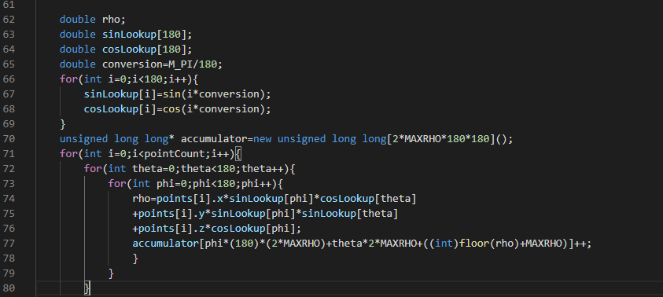
Hough Transform: CPU
}

Slide 7
Hough Transform: Naive GPU
Directly port CPU version to GPU, have each thread cast all votes for one point.
AtomicAdd must be used to prevent collisions in accumulator.
The naive version is a scatter implementation, each thread must have access to the entire accumulator because it is impossible to know where a point will send its votes before it does.
O(n) threads do O(1) work each.

Slide 8
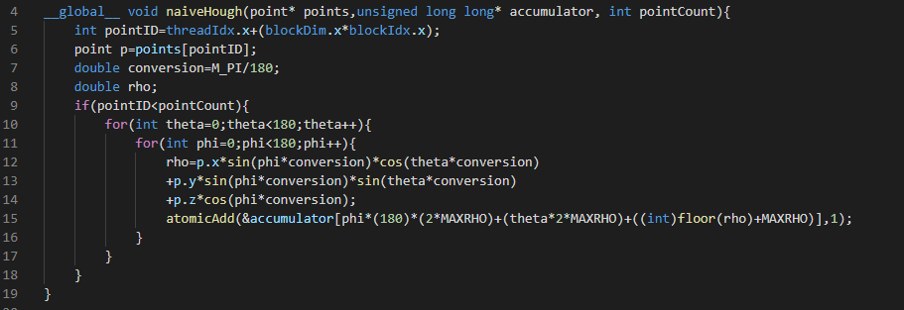
Hough Transform: Naive GPU

Slide 9
Hough Transform: Optimized GPU
Switch from scatter to gather: Each thread is given a pair (Theta,Phi) and calculates the vote each point makes with those values. Each thread has its own row for rho in the accumulator.
This allows:
Removal of atomic add
Storage of sin/cos values in registers.
Storage of points in constant memory.
Giving each thread a local copy of its row to reduce global memory accesses.
O(1) threads with O(n) work each

Slide 10
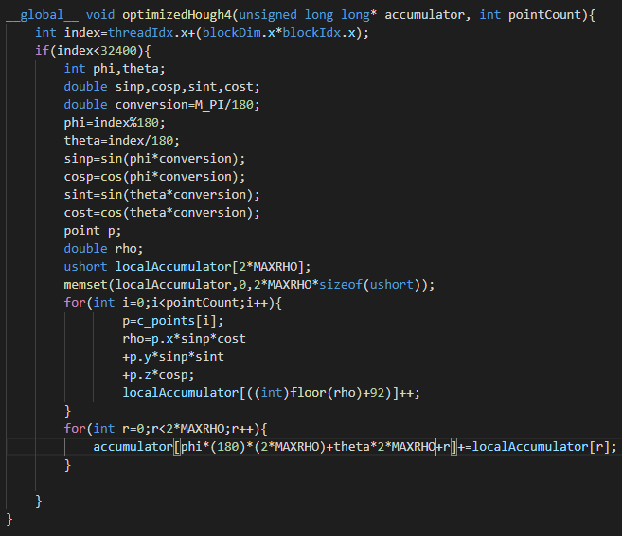
Hough Transform: Optimized GPU

Slide 11
Step 2: Non-maximum Suppression
Compare each bin in the accumulator to its local neighborhood, if it is the maximum in its local neighborhood keep it, if it is not the maximum set it to 0.

Slide 12
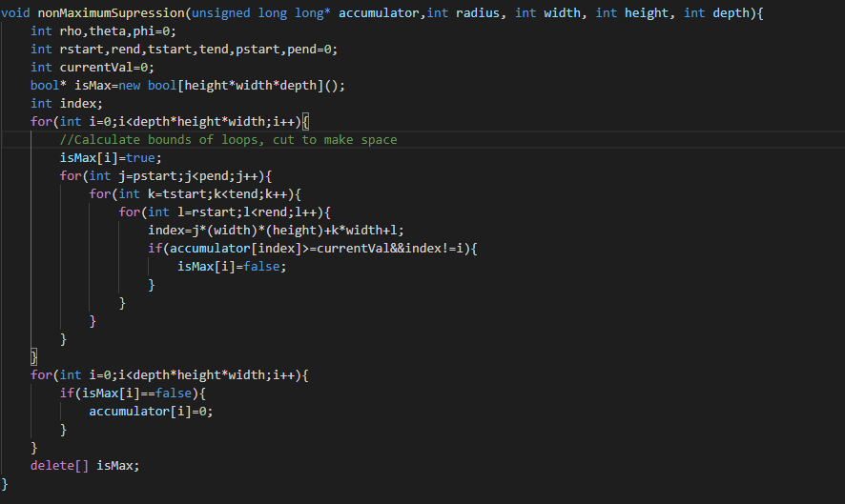
Non-maximum Suppression: CPU

Slide 13
Non-maximum Suppression: Naive GPU
Directly port to CPU version.
One thread per bin, each thread calculate output for that bin.
O(r^3) work per for each thread.
r=radius of neighborhood

Slide 14
Non-maximum Suppression: Optimized GPU
Intention: Tile accumulator in shared memory, have one thread read in one value from the accumulator and write one (or zero) values to the output.
Two problems: Not enough threads, and not enough shared memory.
Result: Tile accumulator in shared memory, have one thread read in one row for rho from the accumulator and write one row for rho to the result.
A 3d grid of 2d blocks.
Shared memory constraints prevent the radius from being large.

Slide 15
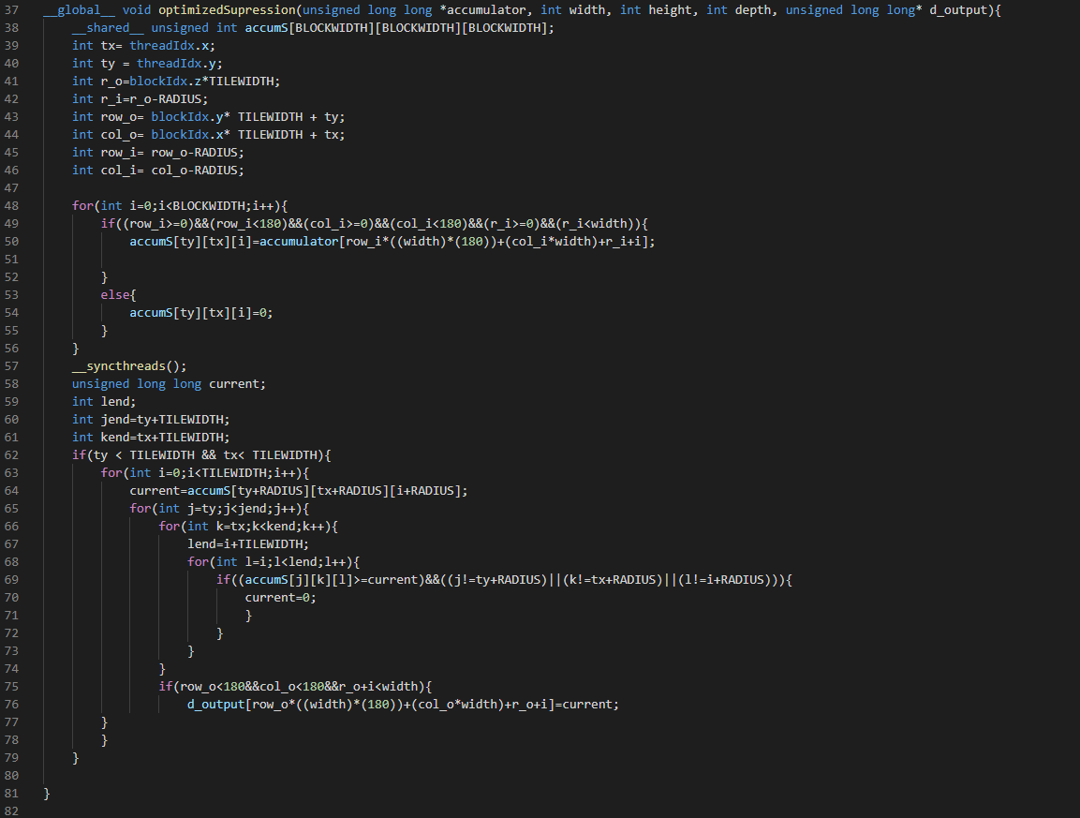
Non-maximum Suppression: Optimized GPU

Slide 16
Step 3: Determine Winning Planes
Pick planes that have the highest number of votes.
Important Note: the desired value is not the number of votes but rather the index of the planes with those votes as the index stores the parameters of the plane.

Slide 17
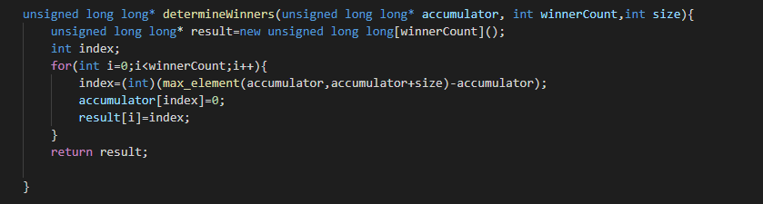
Determine Winning Planes: CPU
Use Built-in C++ function.

Slide 18
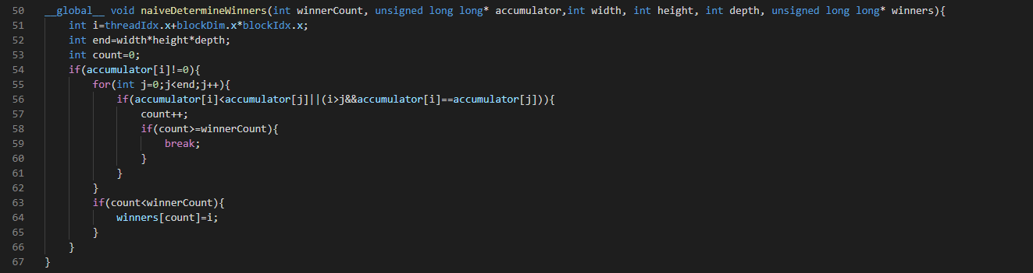
Determine Winning Planes: Naive GPU
Use modified rank sort to determine indices with highest values
Very naive and slow (bad), but gave idea for optimized version.

Slide 19
Determine Winning Planes: Optimized GPU
Perform “Rank reduction” with shared memory.
Basically get the n planes with the highest votes in each block, pass these planes onto next grid launch.
Run last round on CPU.
Drastically reduces global memory usage and comparisons compared to naive implementation.
Each thread does one global memory read and one write.

Slide 20
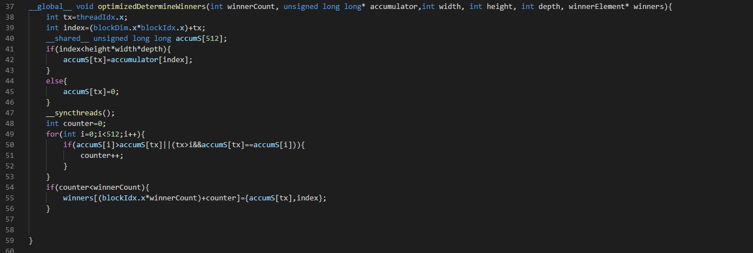
Determine Winning Planes: Optimized GPU

Slide 21
Timing: Number of planes
 | 2 | 5 | 10
CPU | 16s | 16.5s | 17s
Naive Scatter | 2.7s | 2.8s | 3s
Naive Gather | 2s | 2.163s | 2.2s
Optimized Gather | 2s | 2.101s | 2.2s
Optimized nms+Gather | 2s | 2.127s | 2.2s
Optimized Final | .05s | .05s | .05s
Notes:
Points held constant at 1000.

Slide 22
Timing: Number of points
 | 1 | 1000 | 10,000 | 100,000 | 1,000,000 | 10,000,000 | 23,000,000
CPU | 15s | 17s | 23s | 88s | 676s | 6589s | [4h]
Naive scatter | .177s | 3s | 4.2s | 8s | 36.5s | 321s | 729s
Naive gather | .053s | 2.2s | 4.2s | 12s | 75.8s | 718s | 1629s
Optimized gather | .061s | 2.2s | 3.6s | 6.3s | 11.6s | 75s | 161s
Optimized nms+gather | .036s | 2.2s | 2.5s | 6.1s | 11.5s | 75s | 161s
Optimized: Final | .047s | .05s | .1s | .7s | 6.8s | 67s | 152s
Overall Speedup | 319x | 340x | 230x | 125x | 100x | 99x | [95x]
Notes:
Top right and bottom right are estimates, everything else is measured.

Slide 23
Sources
Point cloud from http://semantic3d.net
Based on pseudocode from:
https://robotik.informatik.uni-wuerzburg.de/telematics/download/3dresearch2011.pdf

Slide 24
End
Time for output.

